Slide 1



Online databases for Bacterial Genomics
Workshop: From Bacterial Genomics to Metagenomics
11-15 December 2017, University of Helsinki
João André Carriço,
Microbiology Institute and Instituto de Medicina Molecular,
Faculty of Medicine, University of Lisbon
jcarrico@fm.ul.pt twitter: @jacarrico

Slide 2
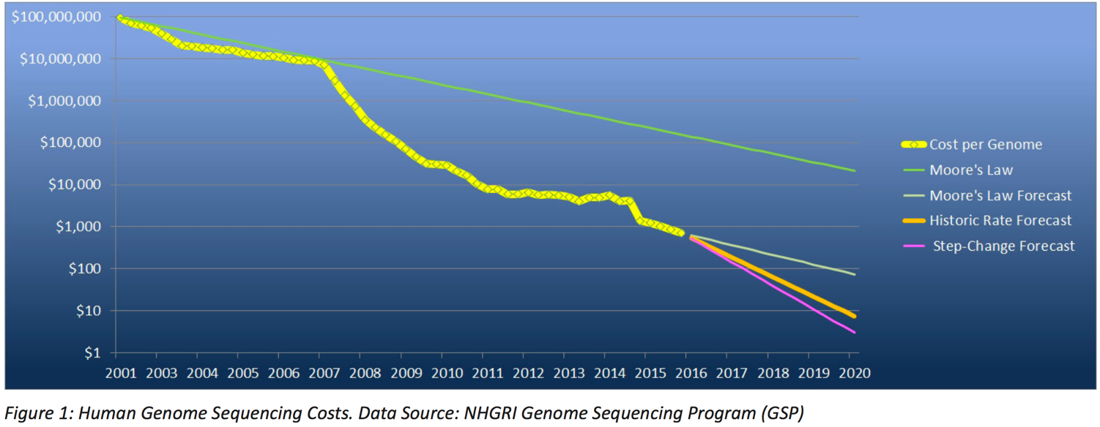
Sequencing Costs are still decreasing
But for bacteria most of cost is library prep….
https://insidehpc.com/2016/11/enabling-personalized-medicine-through-genomic-workflow-acceleration/

Slide 3
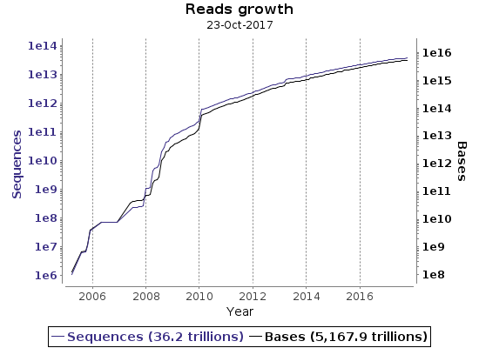
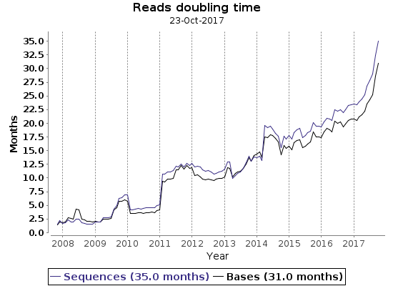

Some Statistics

Slide 4
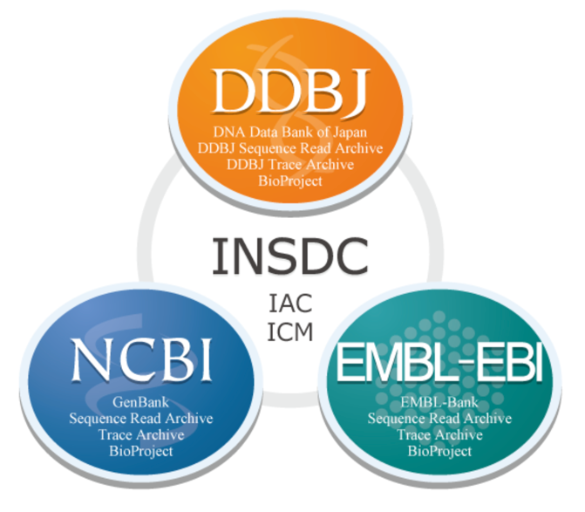
Sequence Databases
Browser access and search
BLAST searches
ftp access
programmatic access : eutils
REST APIs (programmatic access)

Slide 5
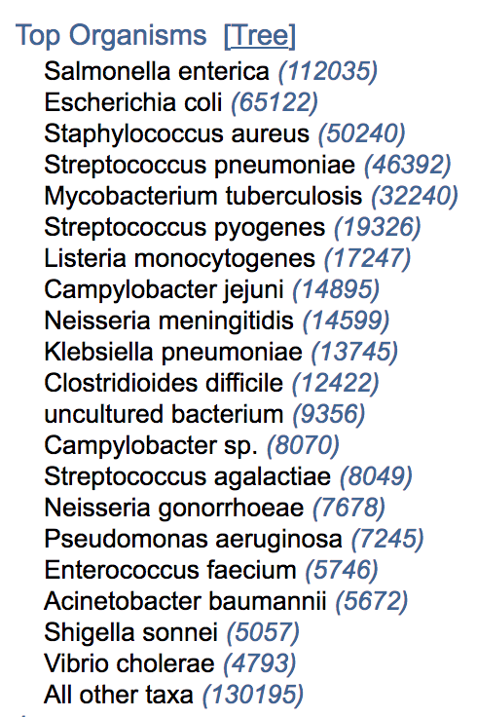
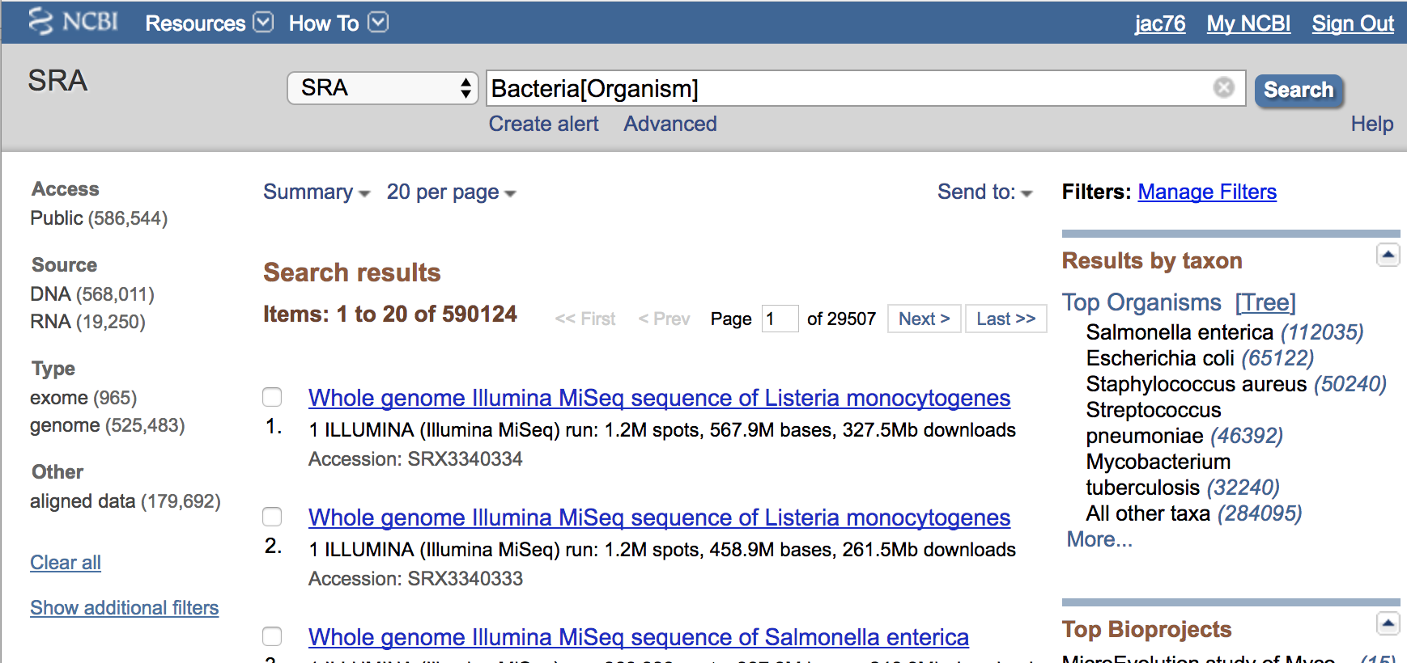
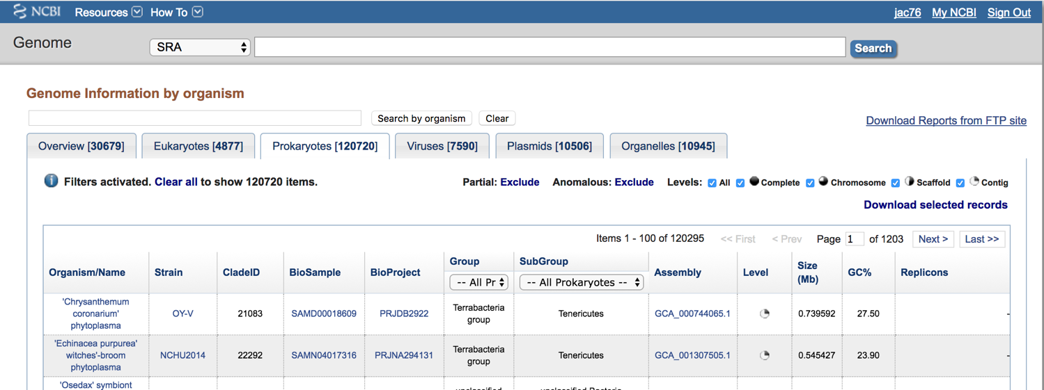
NCBI Sequence Read Archive (SRA)
https://www.ncbi.nlm.nih.gov/genome/browse/?report=2
https://www.ncbi.nlm.nih.gov/sra?term=Bacteria%5BOrganism%5D

Slide 6
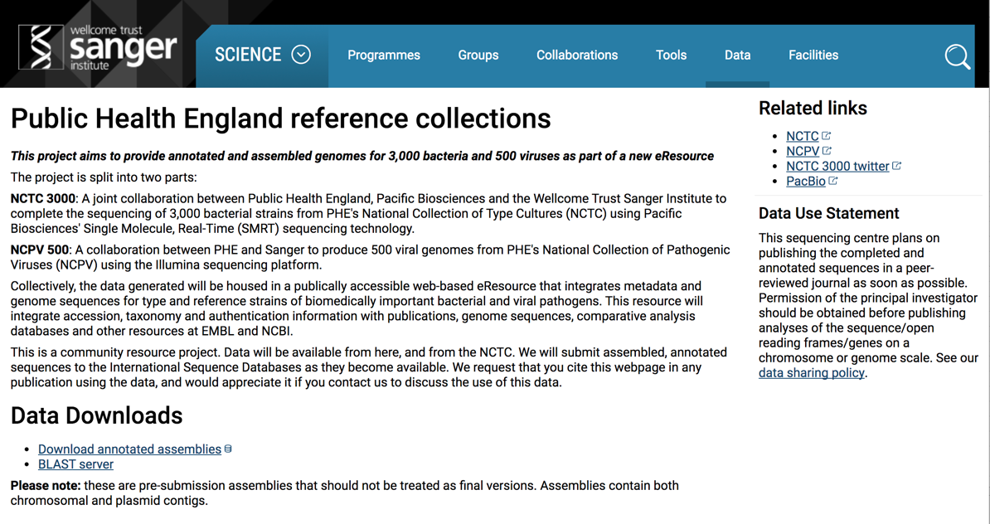
PHE Reference Collection
http://www.sanger.ac.uk/resources/downloads/bacteria/nctc/

Slide 7
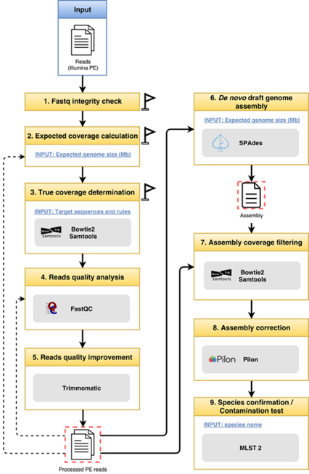



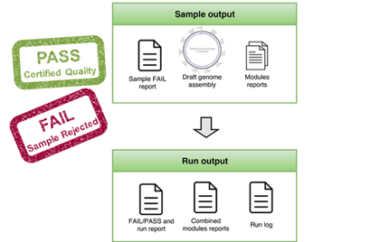


INNUCA: QA/QC Assembly pipeline
https://github.com/INNUENDOCON/INNUca
Dependencies :
Spades
http://cab.spbu.ru/software/spades/
https://github.com/broadinstitute/pilon
MLST 2
https://github.com/tseemann/mlst
http://bowtie-bio.sourceforge.net/bowtie2/index.shtml
samtools
http://www.htslib.org/
http://www.bioinformatics.babraham.ac.uk/projects/fastqc/
Features :
Species confirmation
Contamination detection
Assembly correction
Multiple allele detection -> multiple strains

Slide 8
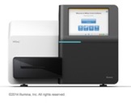

Making the case for High Throughput Sequencing
Completely characterized strain:
Species Identification
Serotype
Multilocus Sequence Type (MLST)
cgMLST / wgMLST / SNPs
Antibiotic resistance profile
Virulence factors
Other SBTM information eg:
spa (S. aureus)
emm (Group A Streptococcus)
The Ideal Scenario
Microbiological
Sample
Actionable information for :
Diagnostics
Surveillance
Outbreak detection
Magic Box of
NGS Wonders for Clinical Microbiology

Slide 9
Need for Databases
Genome Databases
Metaphorical rabbit=
Actionable information
MLST/
cgMLST/
wgMLST
(or any other typing method database)
Antibiotic Resistance Genes
Virulence Factors
Magic Box of
NGS Wonders for Clinical Microbiology

Slide 10
DATABASES
Antibiotic Resistance Databases /Webservices
CARD
ResFinder
Arg-ANNOT

Slide 11
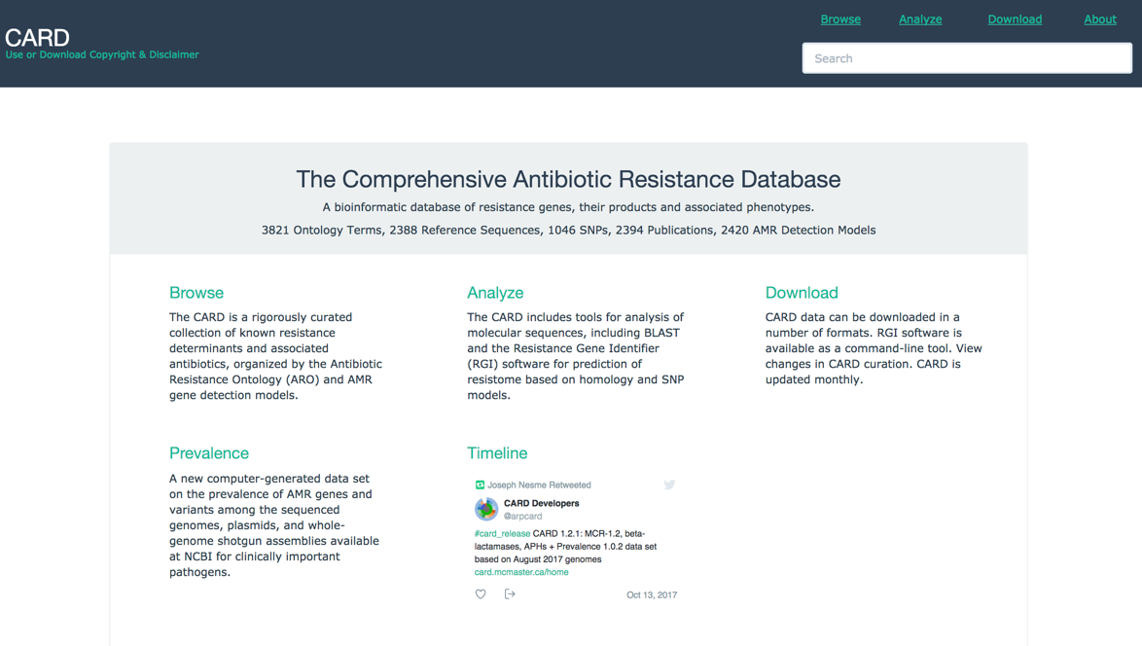
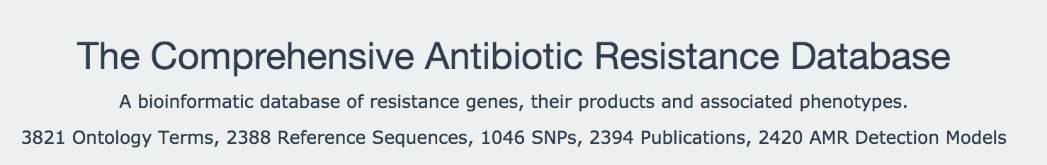
Comprehensive Antimicrobial Resistance Database (CARD)
https://card.mcmaster.ca/

Slide 12
Comprehensive Antimicrobial Resistance Database (CARD)
High quality reference data on the molecular basis of AMR – expert curation.
Organized by the Antibiotic Resistance Ontology (ARO), a theoretical framework for organizing antibiotic resistance information.
Breadth of data – AMR via horizontal gene transfer (HGT) + comprehensive mutation data for genome-based AMR.
Advanced analytics – predicts resistome based on both sequence similarity and mutant detection.
Discovery – development of methods for detection of new variants and emergent threats
Growth – constantly curated resource + building algorithms for detection of AMR mechanisms not examined by other databases (rRNA mutations, van clusters, etc.)
Slide credit: Andrew G. McArthur

Slide 13
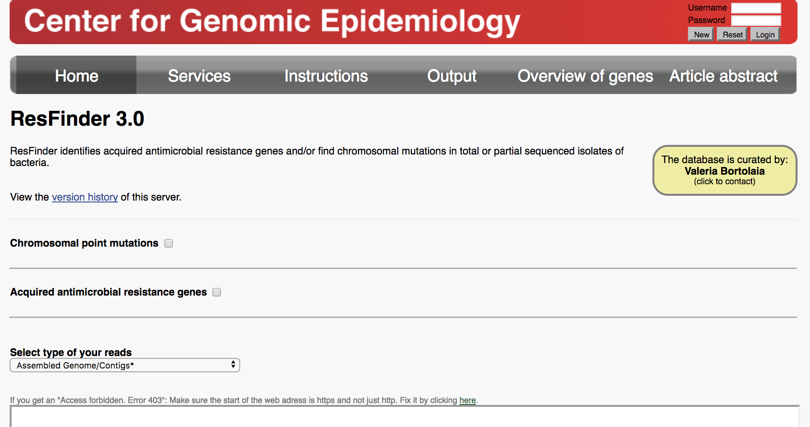
Resfinder v3
Works from reads or assemblies
Gene Presence and Absence
Chromossomal Point Mutations
Download database from: https://bitbucket.org/genomicepidemiology/resfinder_db
Manually curated
https://cge.cbs.dtu.dk/services/ResFinder/

Slide 14
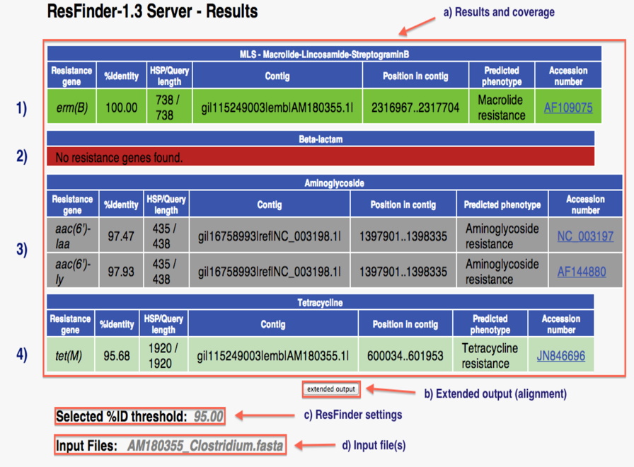
Resfinder v3

Slide 15
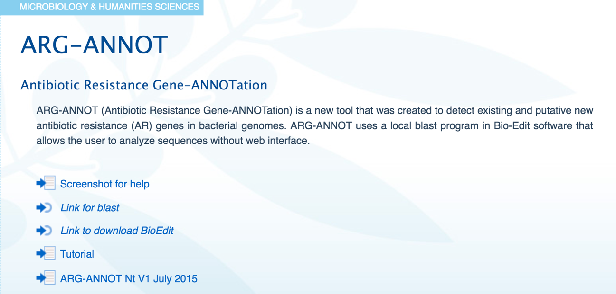
Arg-ANNOT
http://en.mediterranee-infection.com/article.php?laref=283%26titre=arg-annot
Uses BioEdit to locally analyse – no need to upload data
Good tutorial useful for other databases as well

Slide 16
DATABASES
Virulence Factors Database
VFDB
PATRIC VF

Slide 17
What is a virulence factor?
Virulence Factors:
Class of gene products
Help pathogens to invade the host and evade specific host’s defensive mechanisms
Enhance the pathogen’s potential to cause disease

Slide 18
What is a virulence factor?
Virulence Factors (examples):
Bacterial toxins (Endotoxins and Exotoxins)
Adherence factors (Pili)
Cell surface carbohydrates and proteins that protect a bacterium (Streptococcal M Protein)
Hydrolytic enzymes that may contribute to the pathogenicity of the bacterium (hyaluronidase)
Factors to compete with host nutrient uptake (Siderophores)
Sources: VFDB / Medical Microbiology. 4th edition. (http://www.ncbi.nlm.nih.gov/books/NBK7627/)

Slide 19
“Virulome” Databases
VFDB (http://www.mgc.ac.cn/VFs/main.htm)
Pathosystems Resource Integration Center (PATRIC) VF (https)://www.patricbrc.org/)
Victors (http://www.phidias.us/victors/)
PHI-Base (http://www.phi-base.org/)
MvirDB (http://mvirdb.llnl.gov/ )
…

Slide 20
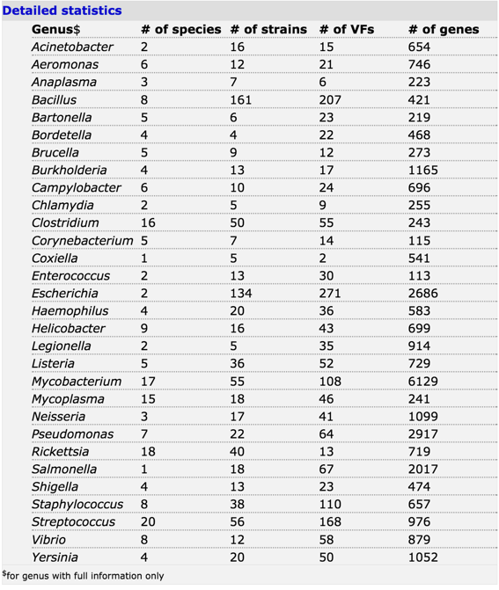
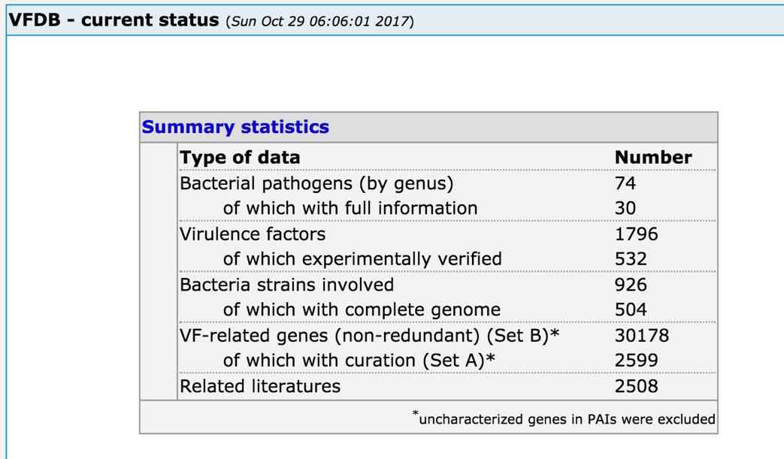
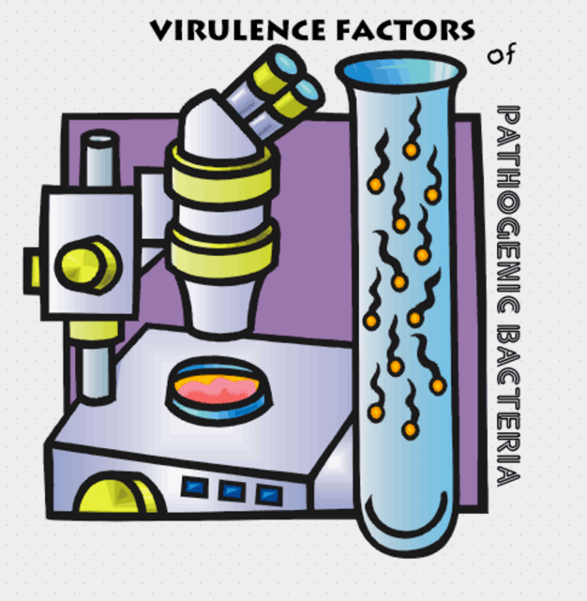
VFDB
http://www.mgc.ac.cn/VFs/
Database last update:
Tue Oct 24 11:48:05 2017
* Created to facilitate the screening of HTS data

Slide 21
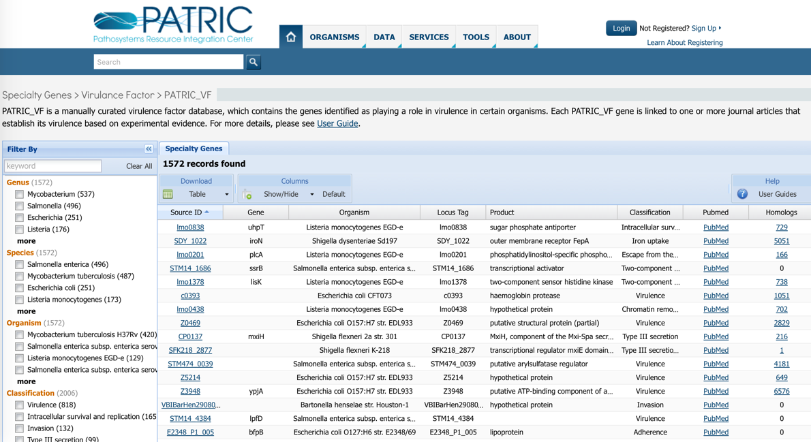
PATRIC VF
Pathosystems Resource Integration Center
https://www.patricbrc.org/
6 NIAID priority genera:
Mycobacterium
Salmonella
Escherichia
Shigella
Listeria
Bartonella
1572 VFs
1071 articles
Use of controlled vocabulary
Integrates VFDB and Victors VF information
PATRIC supports:
Genome annotation
Comparative Genomics
Transcriptomics
Pathways
Host-pathogen interaction
Disease-related information
Database last update:
March 2016 (?)

Slide 22
DATABASES
Schema Databases
Pubmlst
Enterobase
cgMLST.org

Slide 23
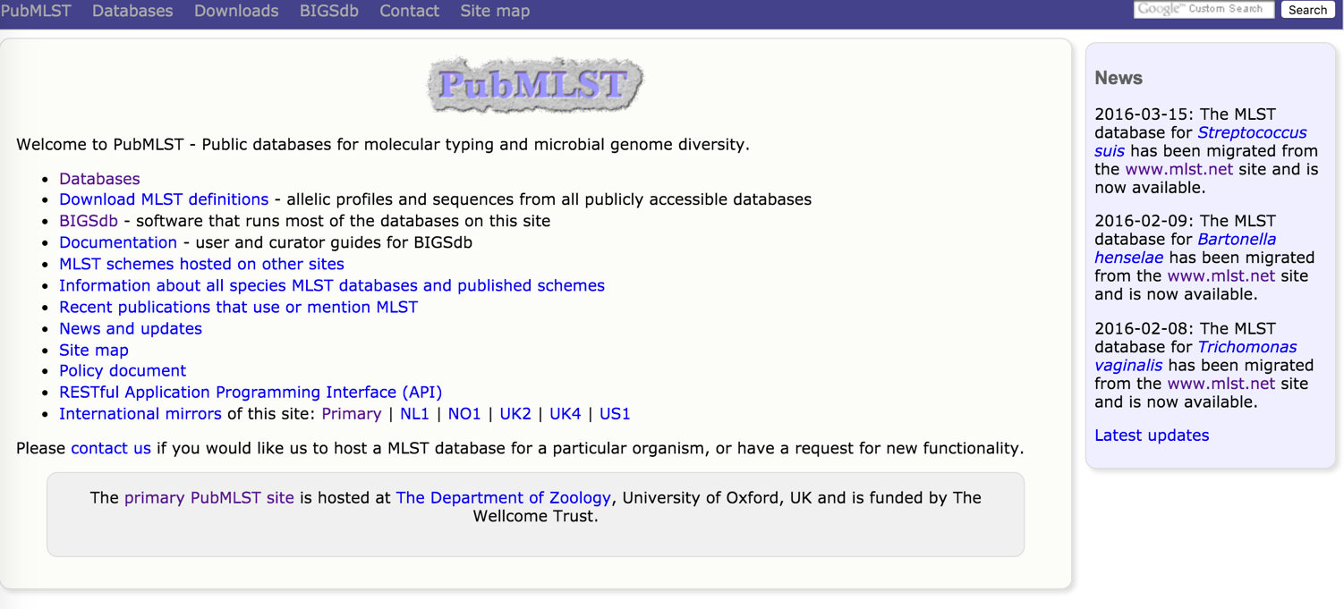
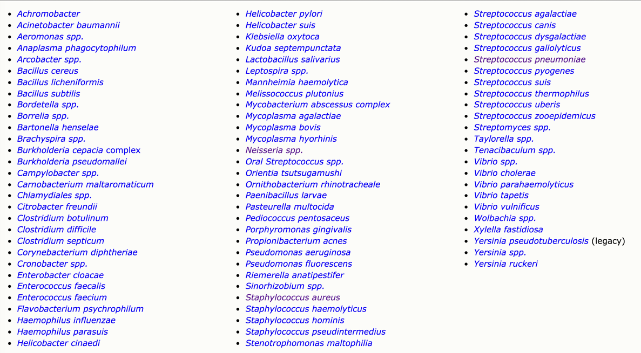
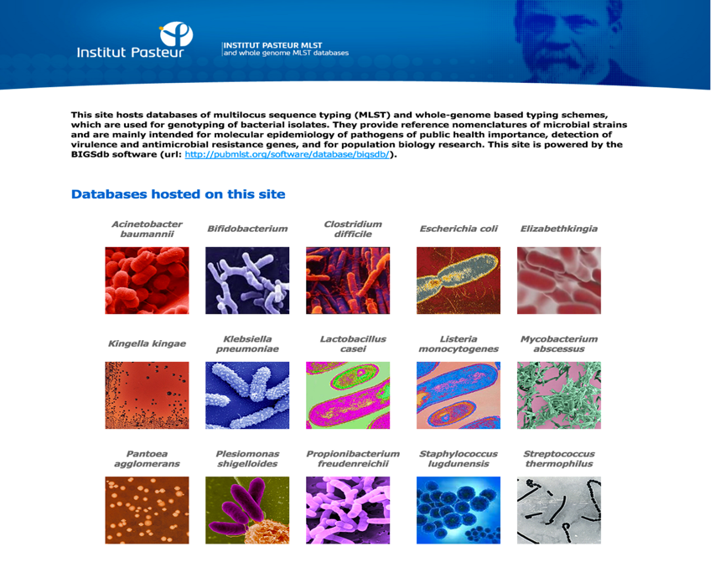
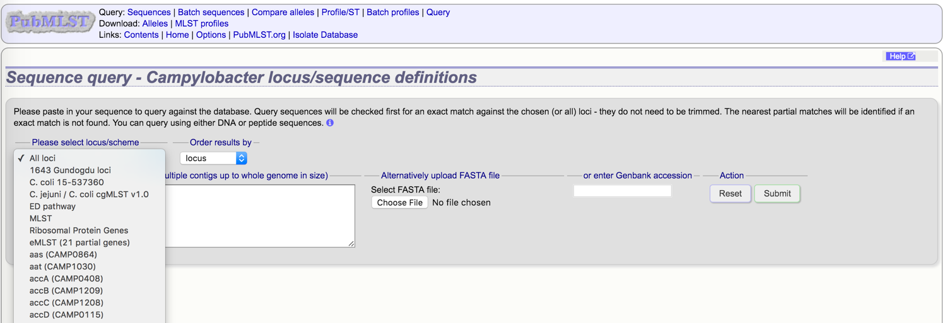
Sequence Based Typing : Pubmlst /BIGSdb
http://www.pubmlst.org
http://bigsdb.web.pasteur.fr/

Slide 24
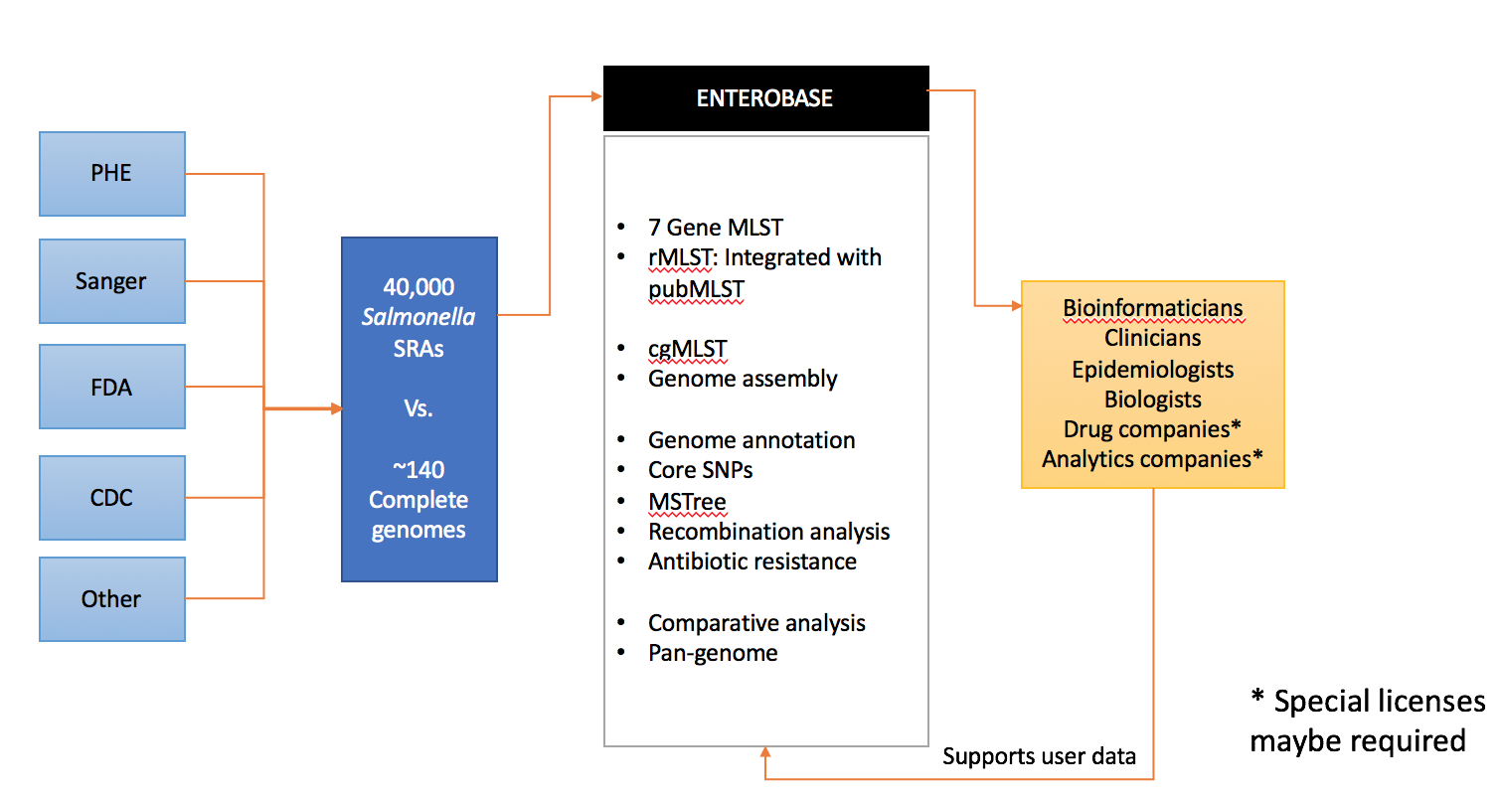
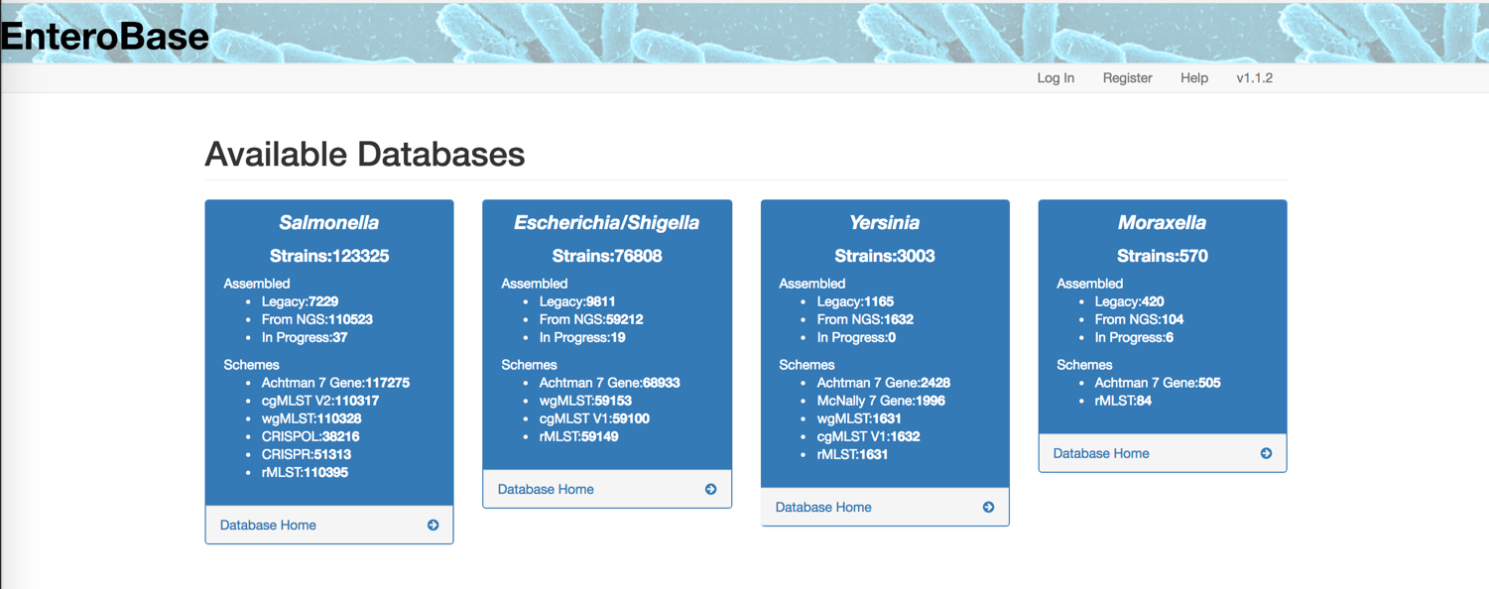
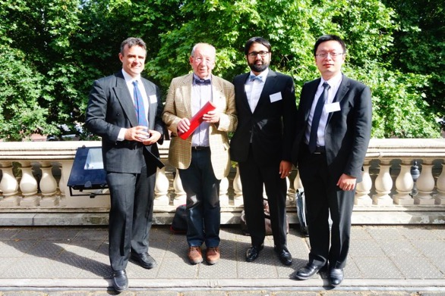
Sequence Based Typing : Enterobase
Martin Sergeant
Mark Achtman
Nabil-Fareed Alikhan
Zhemin Zhou
Slide Credit :
Nabil-Fareed Alikhan

Slide 25
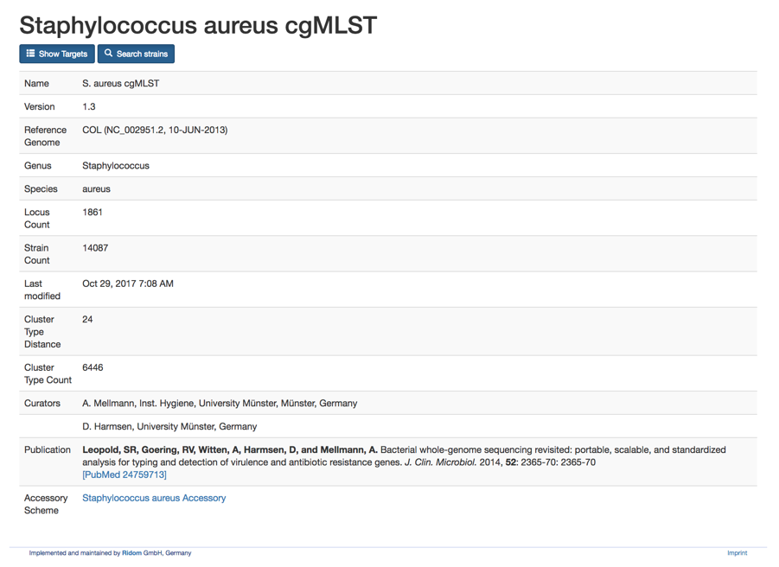
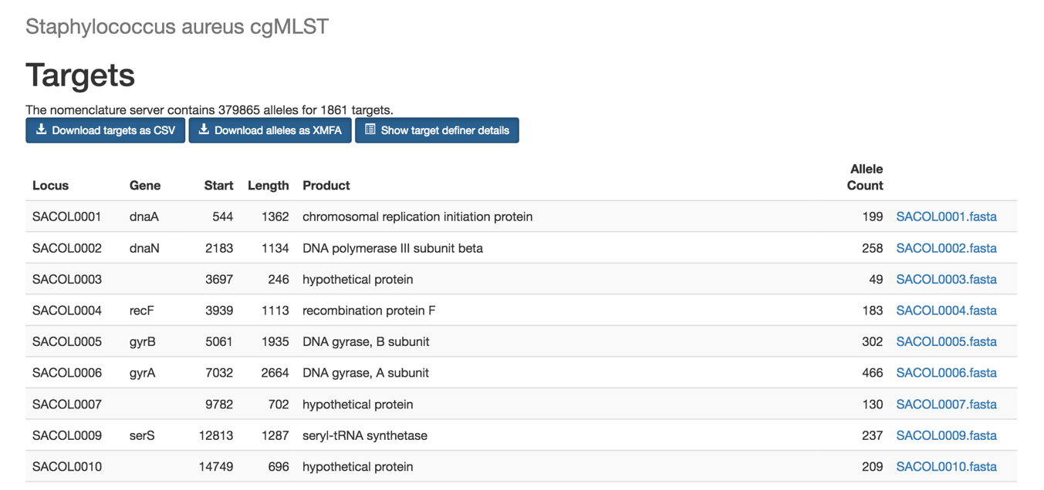
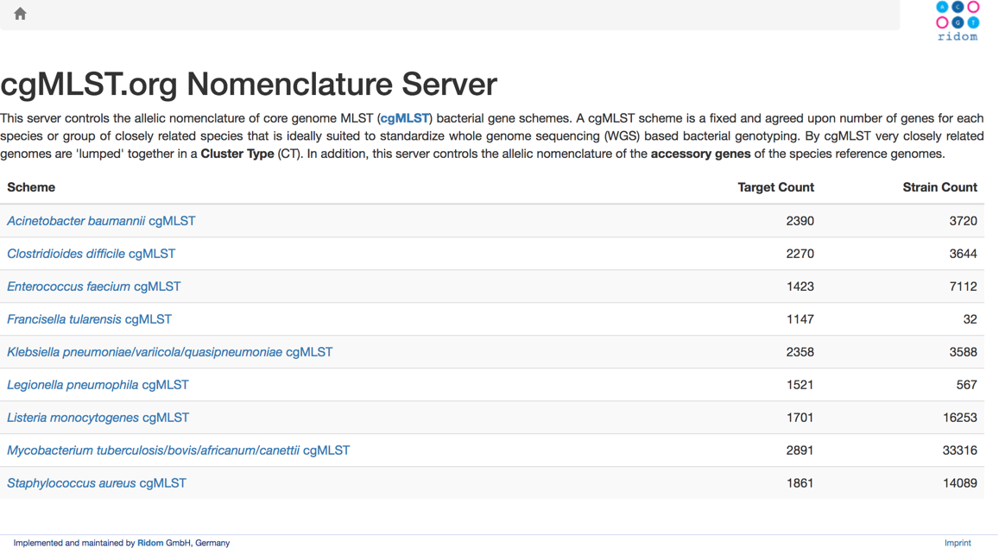
cgMLST.org

Slide 26
Other DATABASES
ICEberg
Integral
And many more….

Slide 27
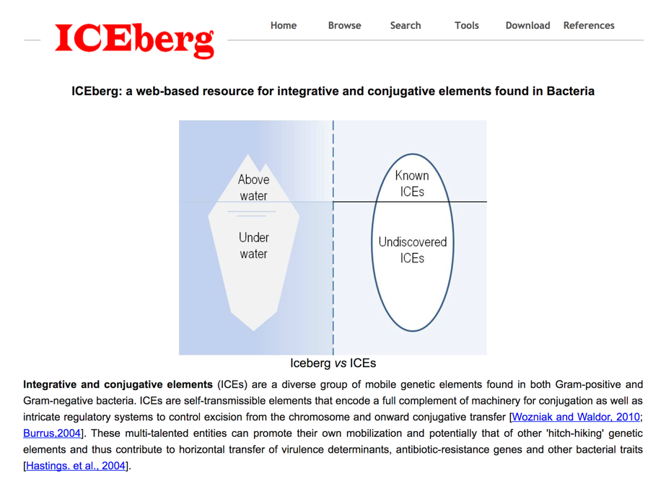
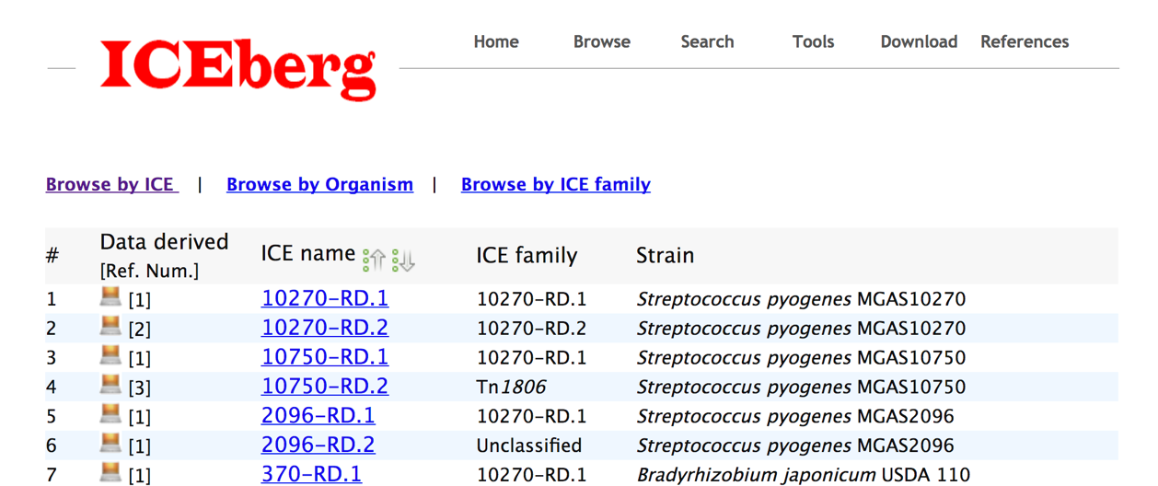
ICEberg
http://db-mml.sjtu.edu.cn/ICEberg/

Slide 28
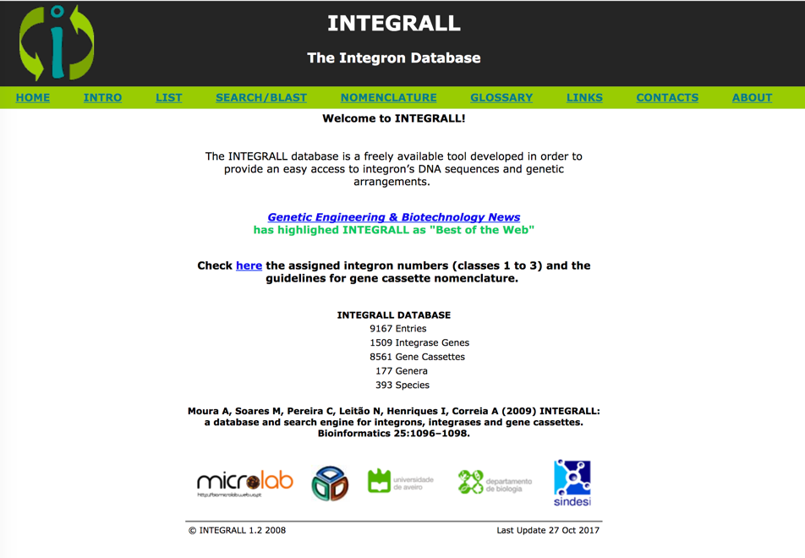
Integral
Integrons
allow bacteria to capture and express gene cassettes
Composed of :
intI
a recombination site attI
gene cassetes
http://integrall.bio.ua.pt/

Slide 29
Databases Greatest Strengths
All the databases have:
manually curated data
links for the original publication (?)
However manual curation is a huge caveat due to the sustainability of the process

Slide 30
How to use these resources
Querying annotation in the the website
Selecting species of interest, and browsing the website
BLAST query for DNA or Protein

Slide 31
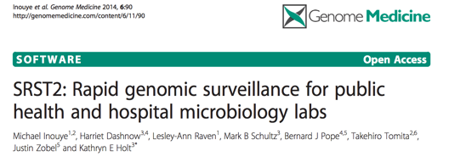

How to use these resources
Download the gene/protein databases
and use them as templates for searching own data
Analysis from the Reads
Analysis from the assemblies
ABRICATE
https://github.com/katholt/srst2
https://github.com/B-UMMI/ReMatCh
https://github.com/tseemann/abricate
Pre-packed with 7 DBs:
Resfinder, CARD, ARG-ANNOT, NCBI BARRGD, NCBI, EcOH, PlasmidFinder and VFDB.

Slide 32
Conclusions
“Sharing is Caring”
Database sustainability
Data /Web services Privacy issues
Data Quality issues
No need to reinvent the wheel: Nomenclature issues – use of ontologies

Slide 33
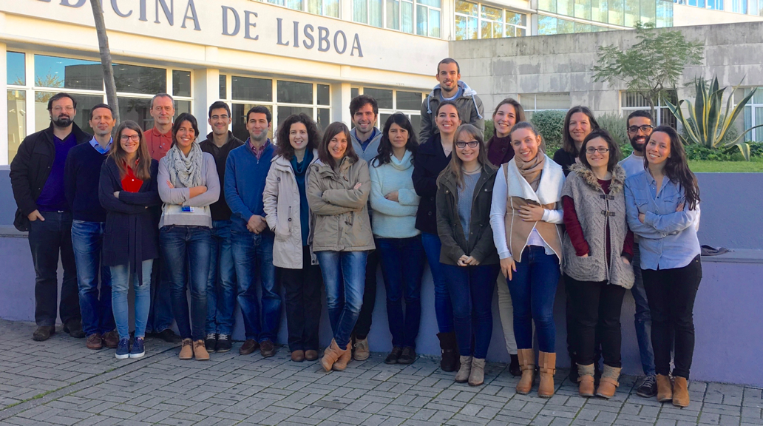
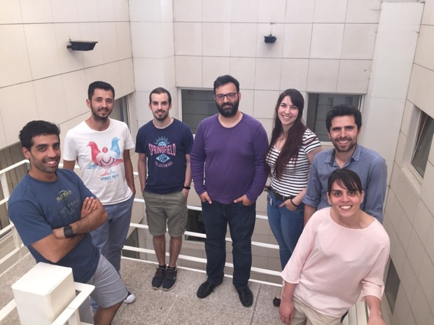
Acknowledgments
http://im.fm.ul.pt

Slide 34







Acknowledgments
INNUENDO project [GP/EFSA/AFSCO/2015/01/CT2]
BacGenTrack project [FCT / Scientific and Technological Research Council of Turkey, TUBITAK/0004/2014]
ONEIDA project (LISBOA-01-0145-FEDER-016417) co-funded by FEEI - “Fundos Europeus Estruturais e de Investimento” from “Programa Operacional Regional Lisboa 2020” and by national funds from FCT - “Fundação para a Ciência e Tecnologia”
Disclaimer
The conclusions, findings, and opinions expressed in this presentation reflect only the view of the INNUENDO consortium members and not the official position of the European Food Safety Authority nor of the Government of the Basque Country that are not responsible for any use that may be made of the information they contain.

